Slide 1
Text Detection and Recognition from Scenes
Varun Sharma

Slide 2
Progress So Far
Fixed OpenCV bugs and got massive improvements on performance
Developed within a Conda env (does this need changing)
Padding = 0.05 or 0.1 works best (sometimes 0)

Slide 3
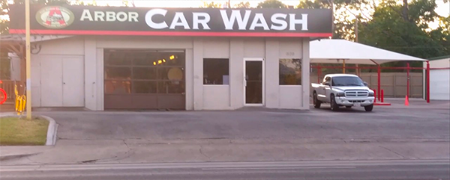
ARBOR | CAR WASH

Slide 4
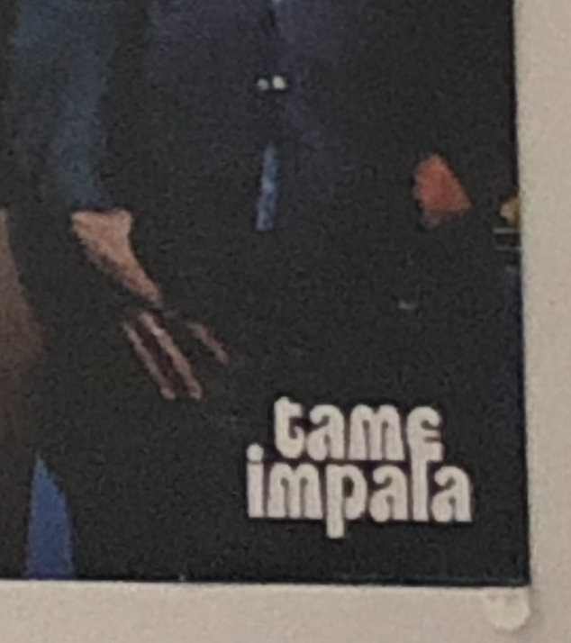
AS IMPALA

Slide 5
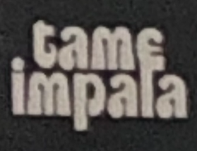
EE IMPALA

Slide 6

Fails

Slide 7
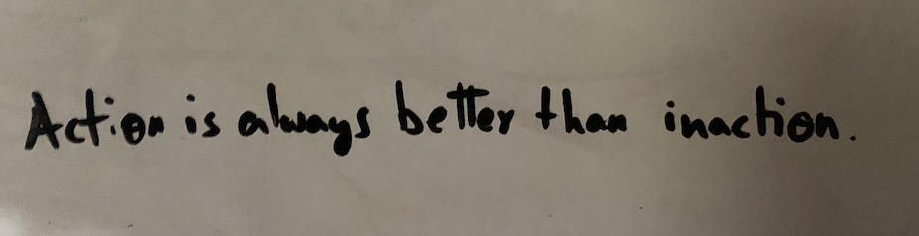
Fails (more or less)

Slide 8
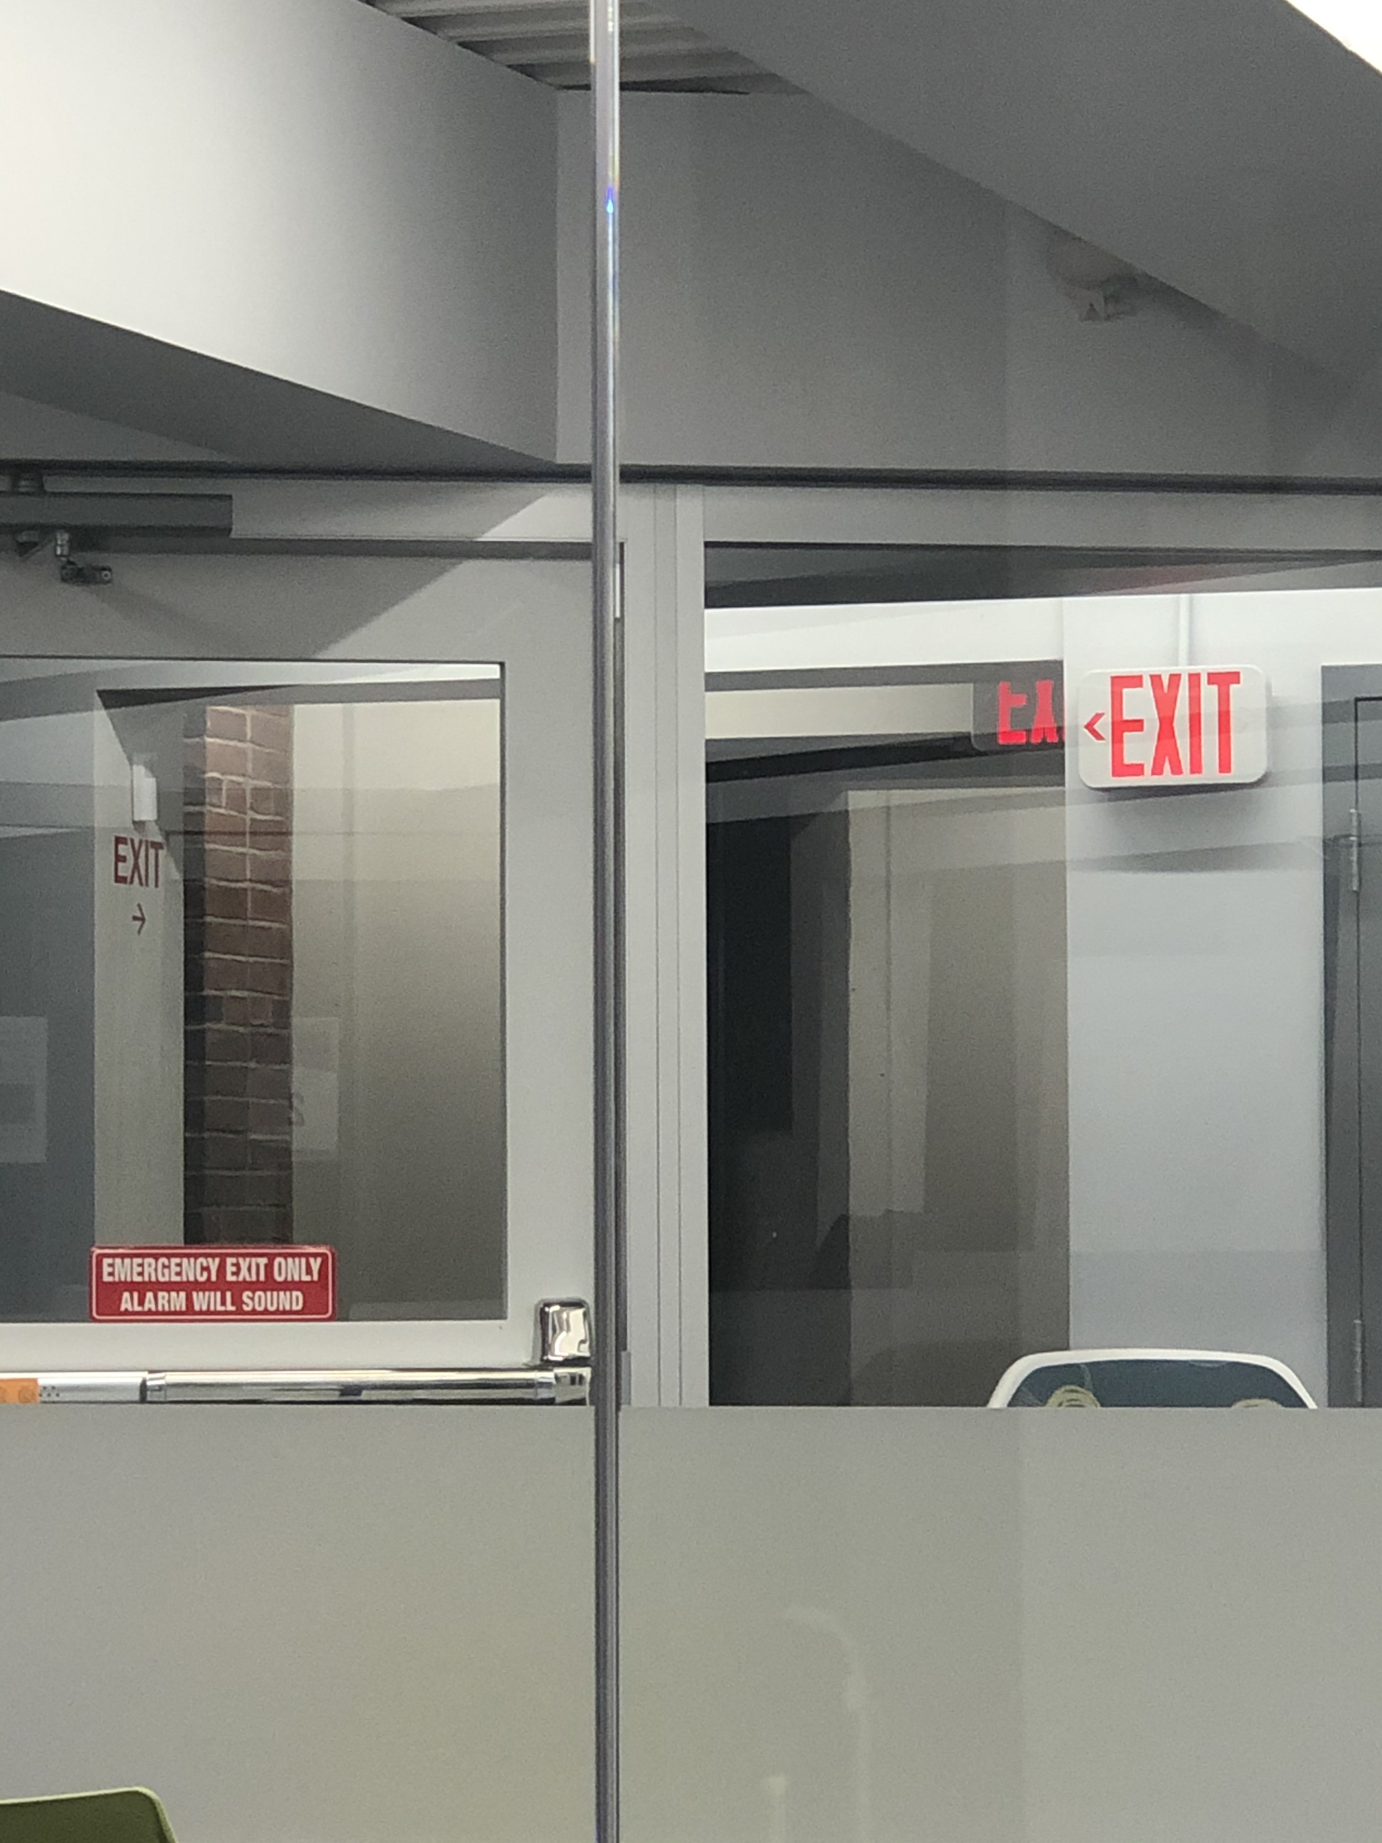
Fails

Slide 9
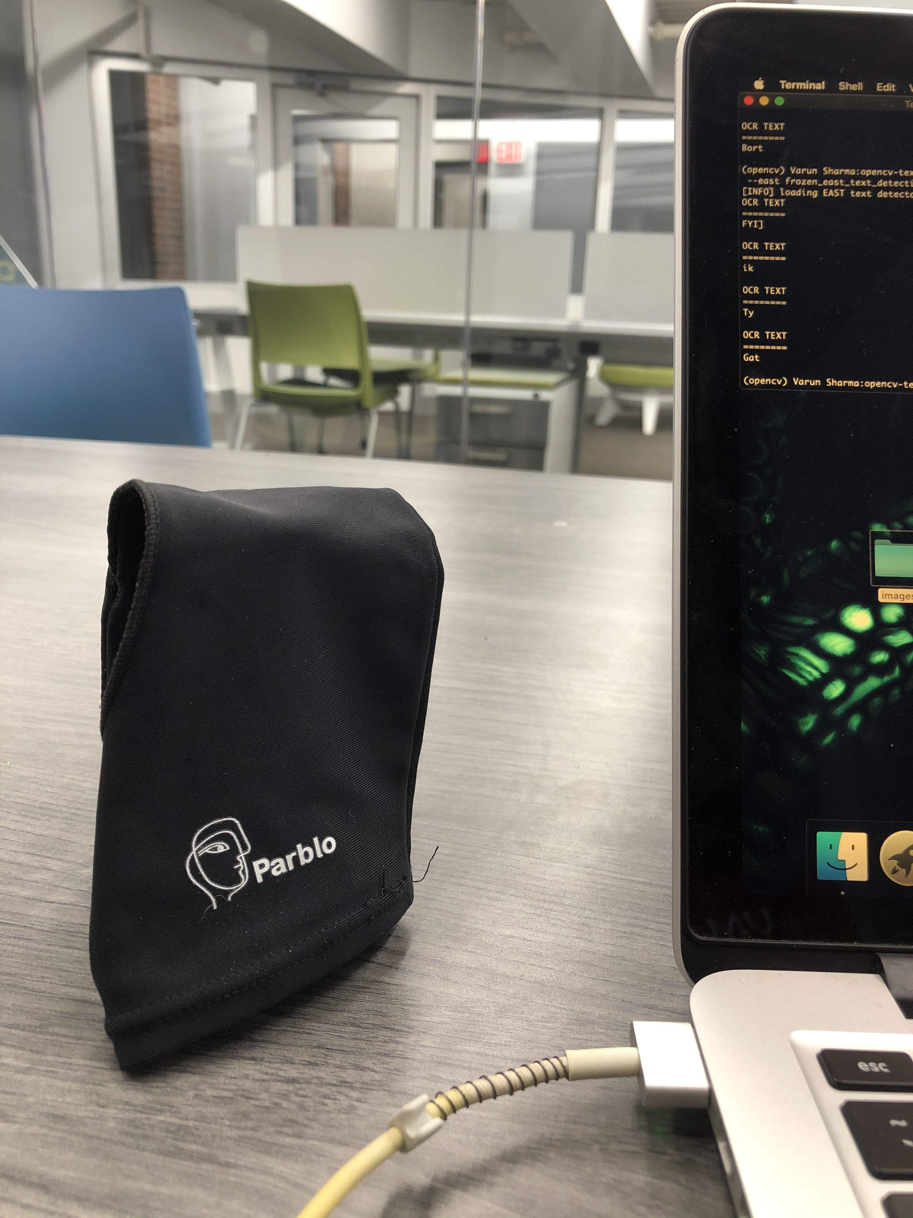
Fails

Slide 10
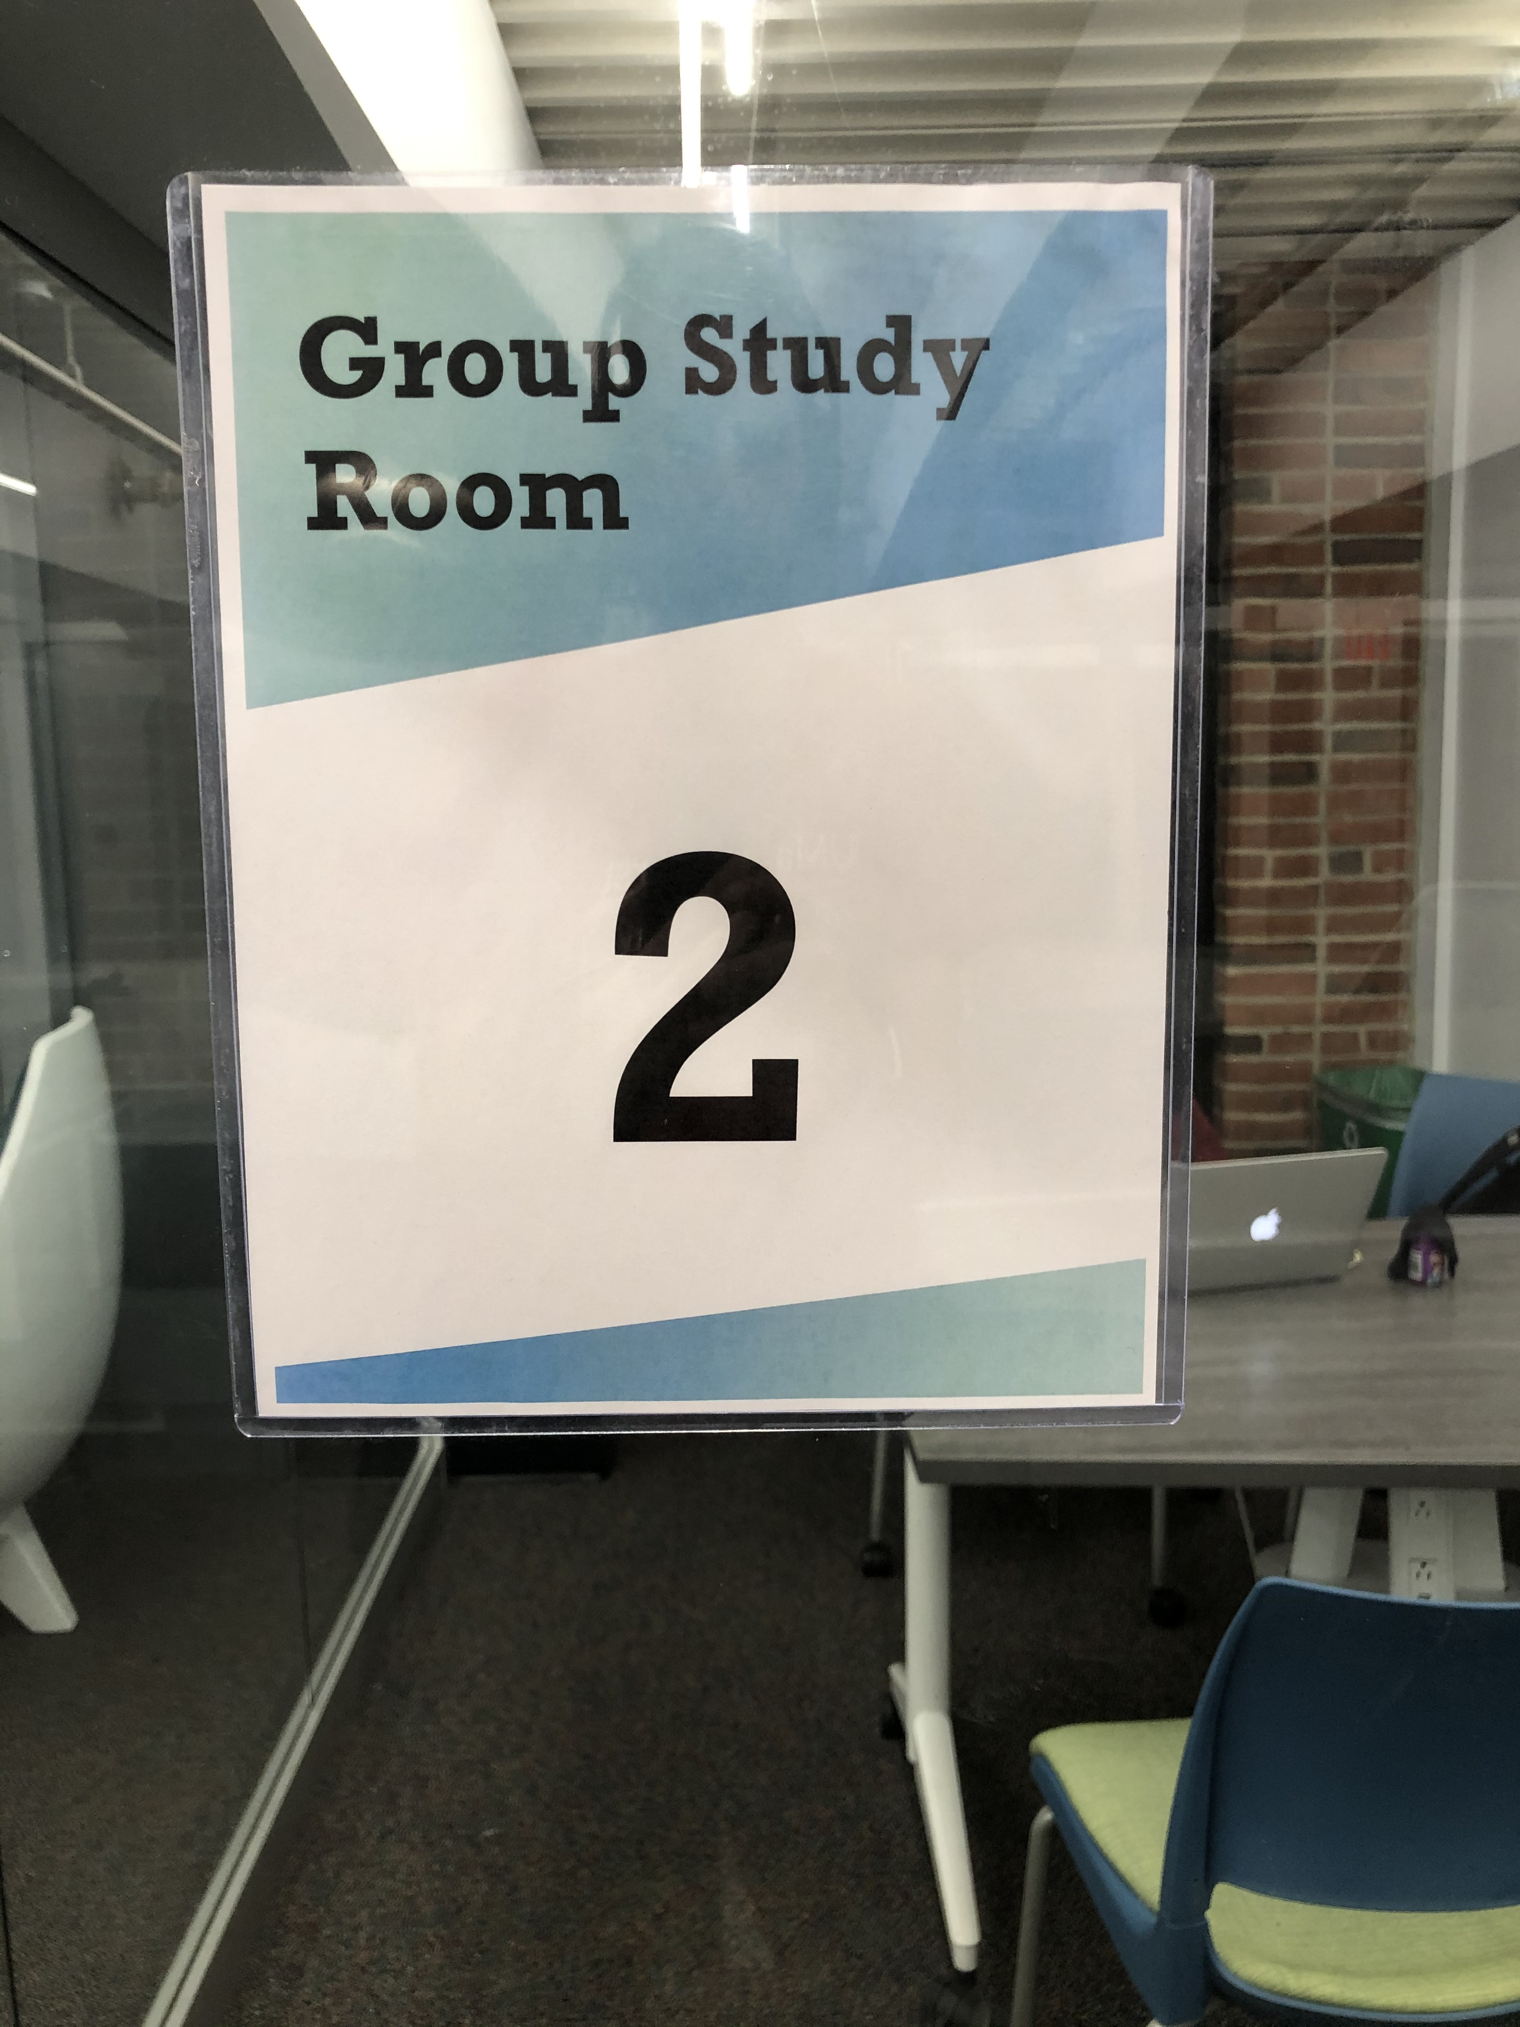
Group Study Room

Slide 11
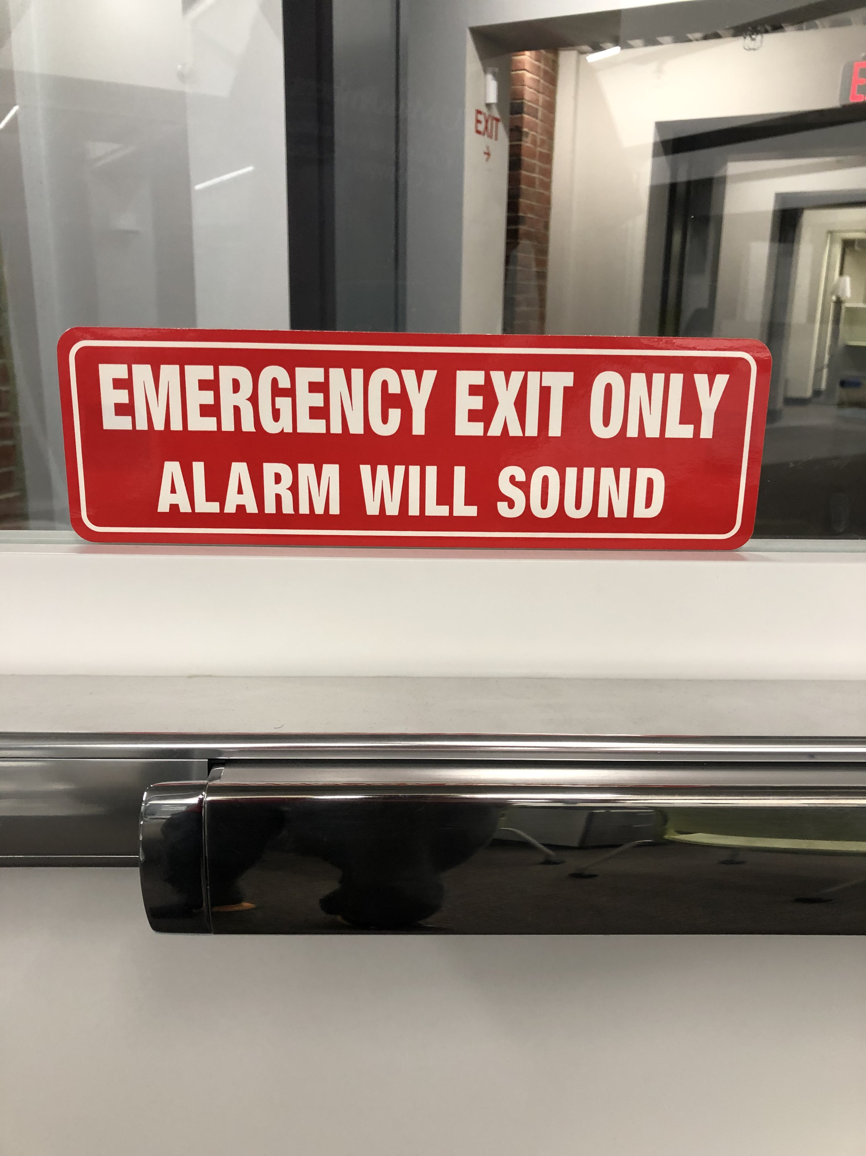
Fails

Slide 12
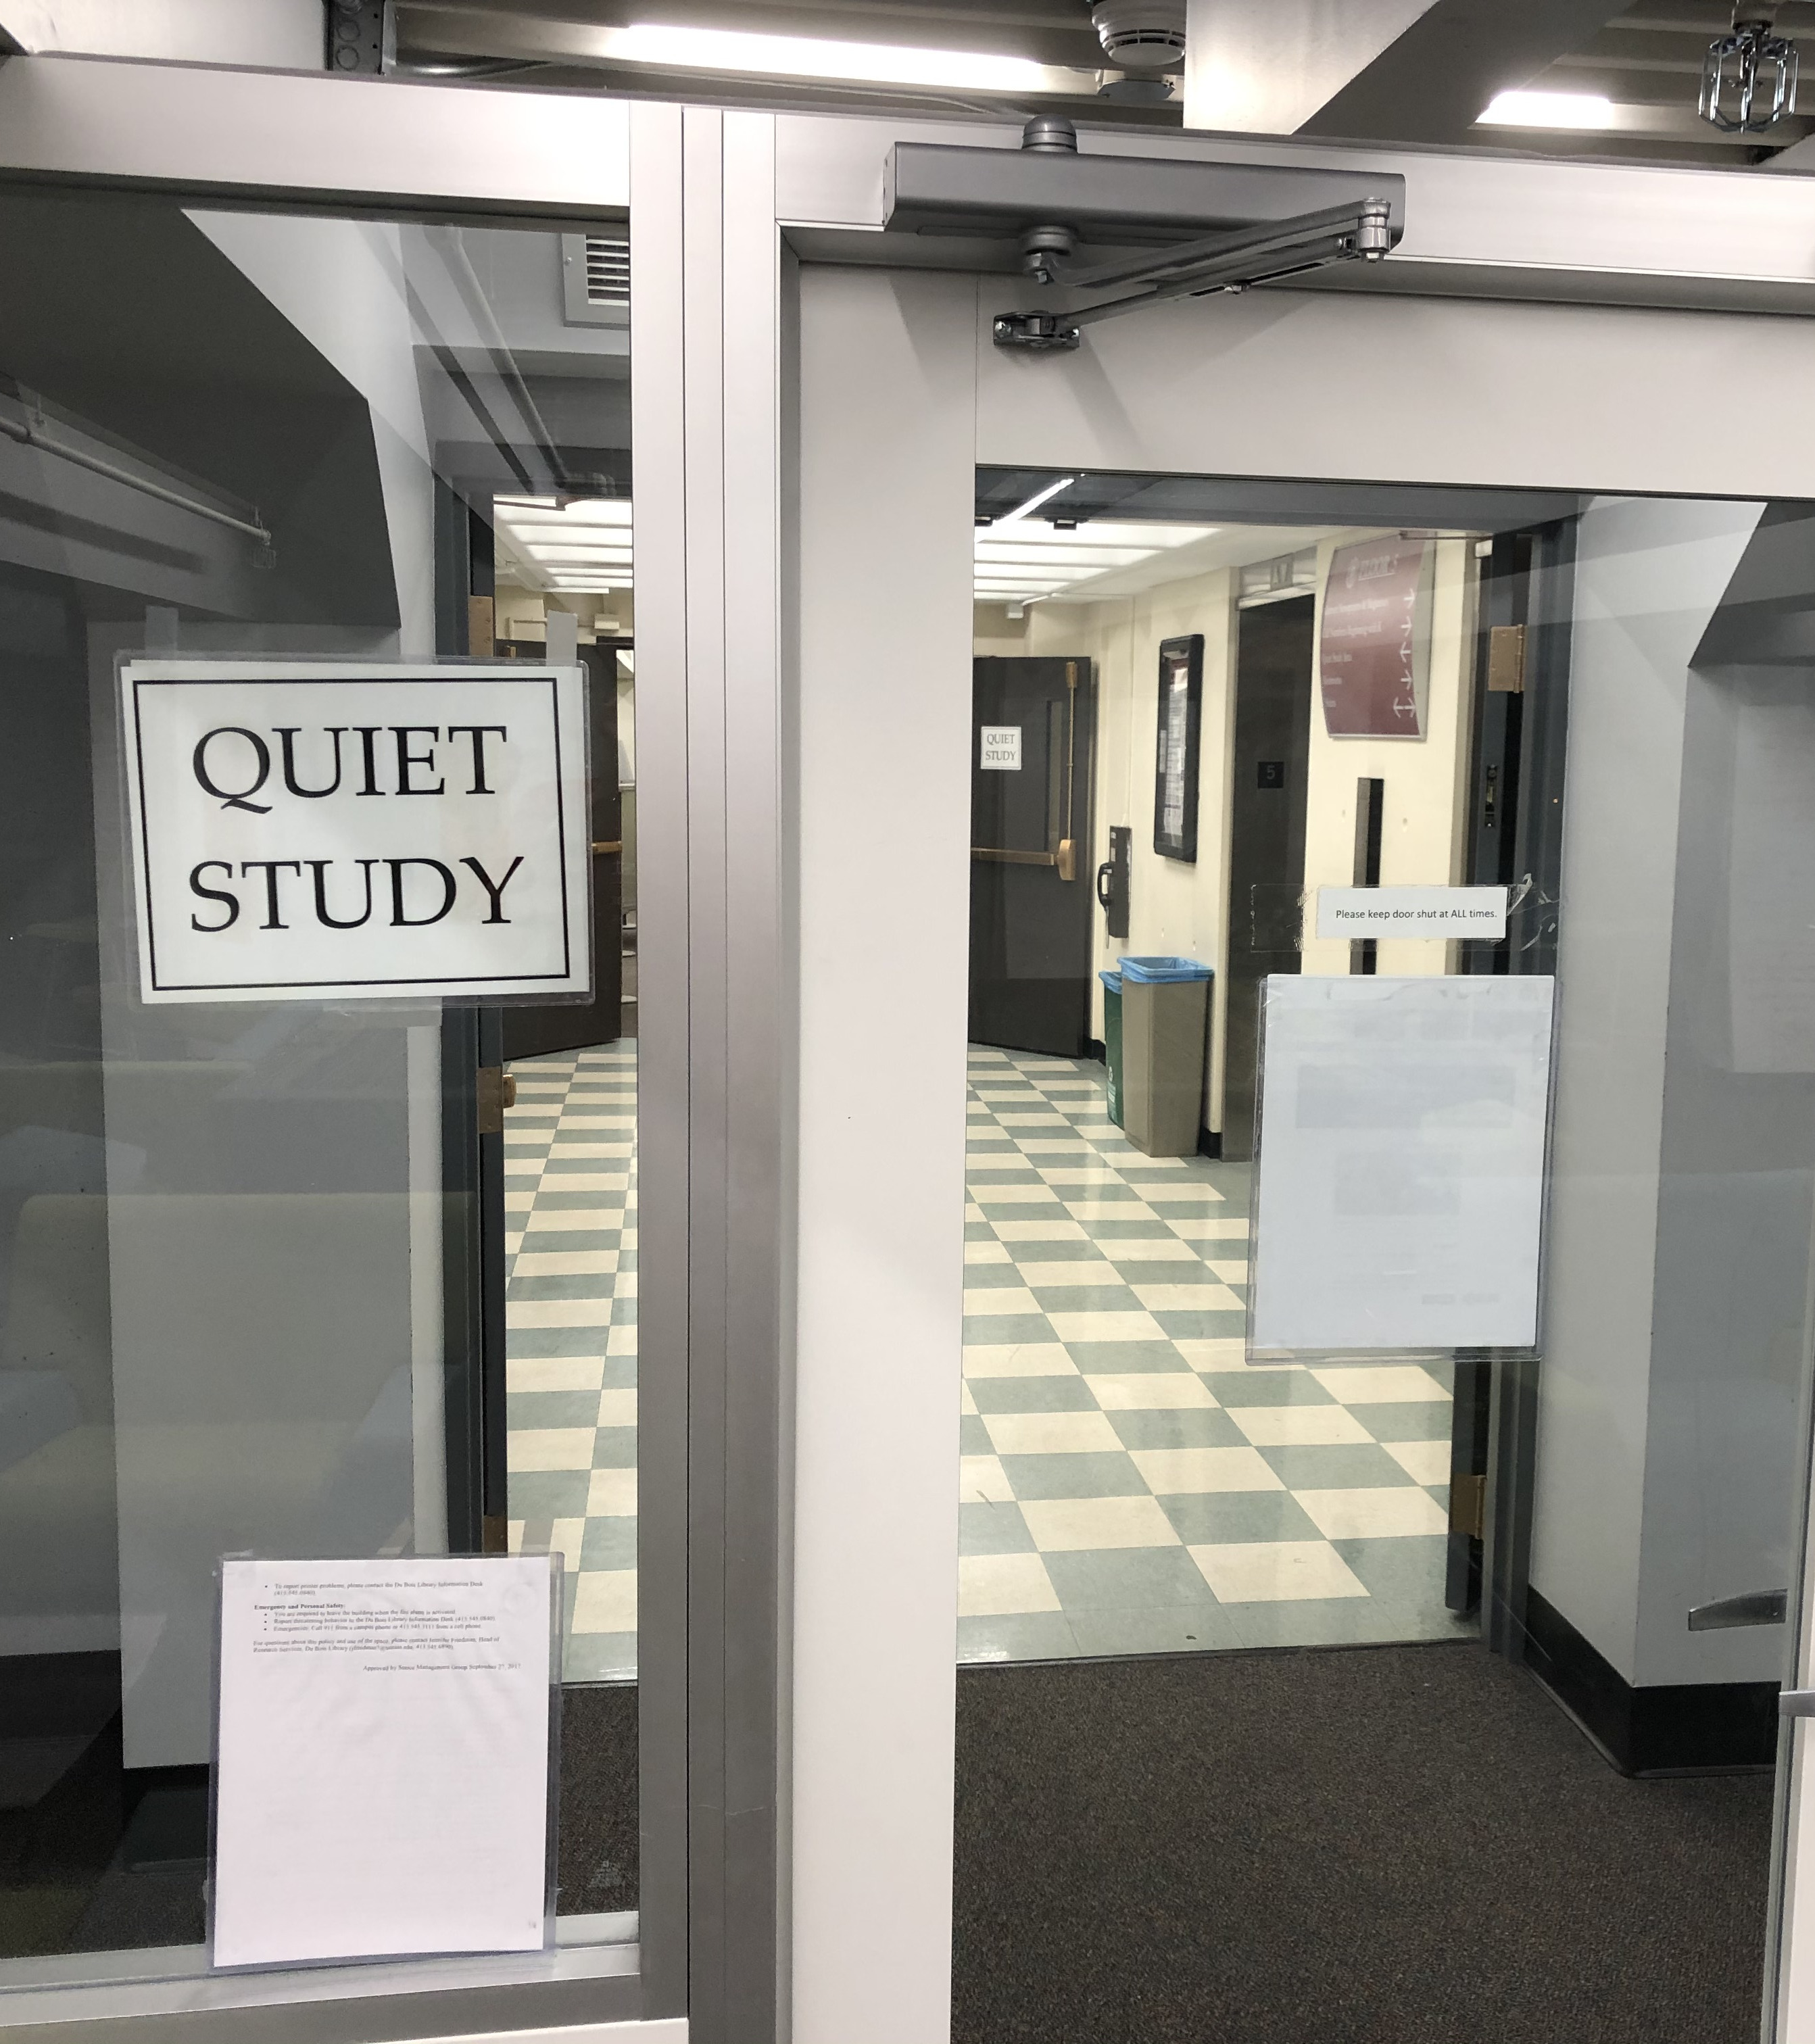
Quiet Study

Slide 13
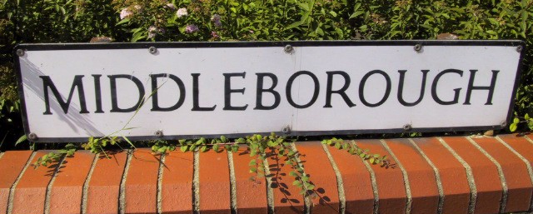
MIDDLEBOROUGH

Slide 14

ESTATE AGENTS SAXSONS

Slide 15
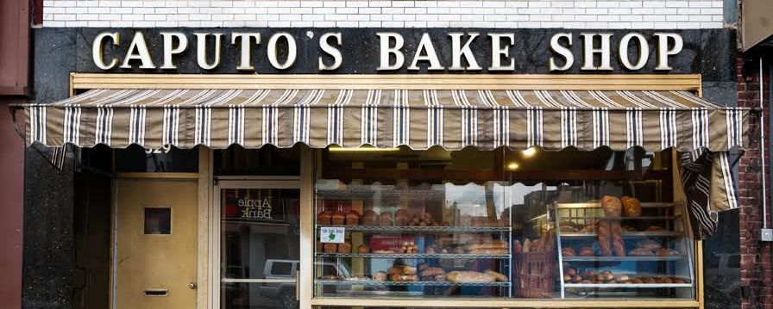
CAPUTO’S BAKE SHOP

Slide 16

Fails

Slide 17
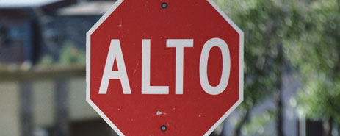
ALTO

Slide 18
Next Steps
(Potentially) write a script to make installation easier
Get feedback from Dan about usability, getting everything running, etc
Move on to chat logs

